Slide 1
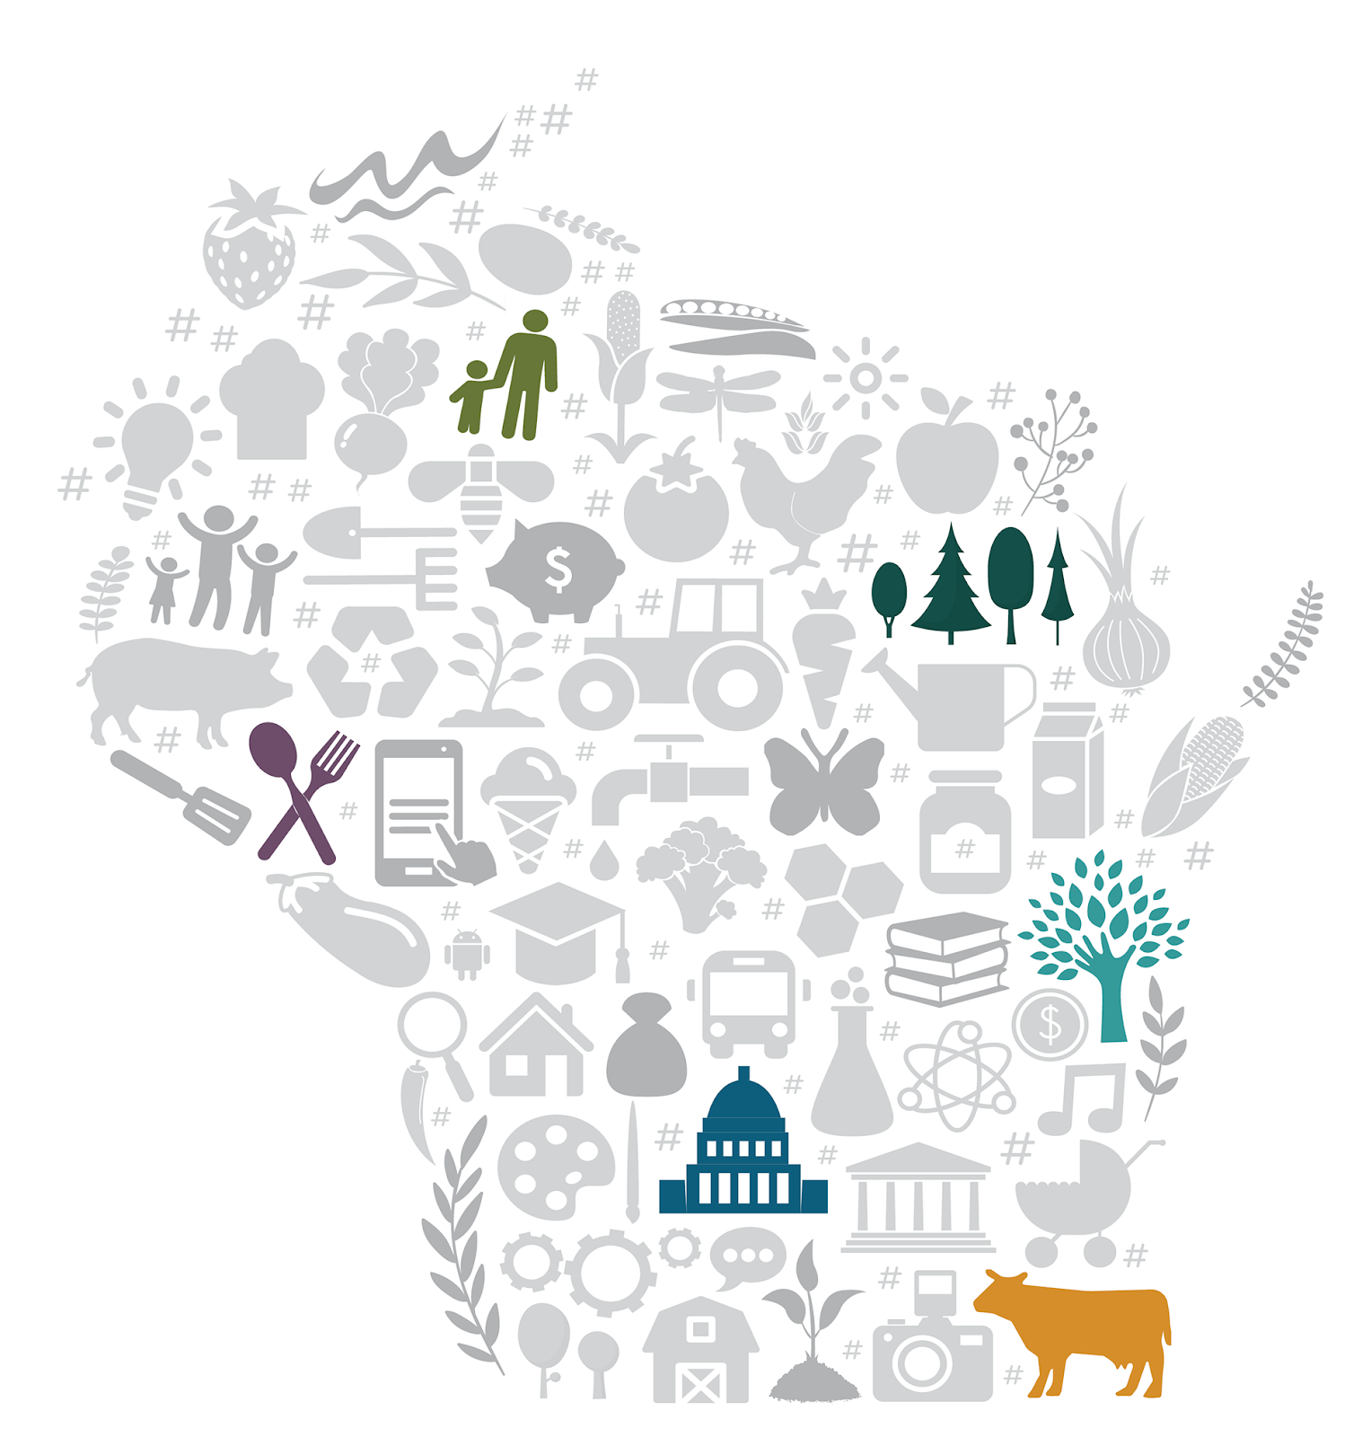


Session 3 Role Play: Conversation Examples
Notes:
Images and icons provided from flaticon.com

Slide 2


1. Identify which of the big four conversations you can have using the source material.
2. Brainstorm a question that you could ask related to that topic.
3. Imagine what your child’s response would be. How would you affirm it?
4. Brainstorm what you could say to assist your child in connecting with the topic you identified.
5. Practice having that conversation with your partner.
Your Turn
See pg. 23 of the handbook for worksheet!
See pg. 24-27 of the handbook for ideas!

Slide 3




The Big Four
Racial Literacy
Individuals
Empathy
Action

Slide 4
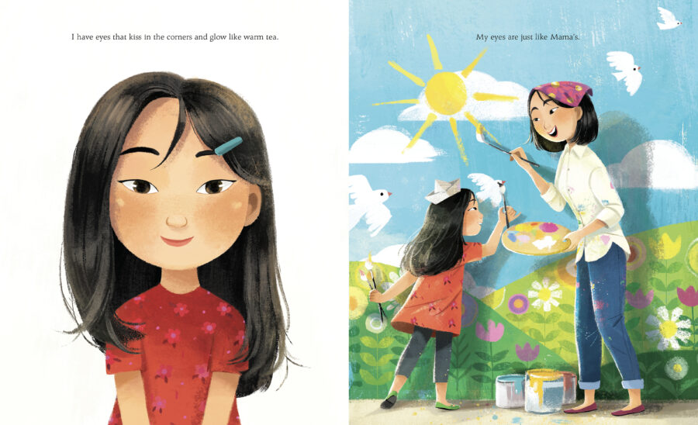




Ask
Affirm
Assist
From Eyes that Kiss in the Corners by Joanna Ho
©️ 2021 Scholastic Books
Notes:
In this story: A young Asian girl notices that her eyes look different from her peers’. Her friends have big, round eyes and long lashes. But her eyes are like her mother’s, her grandmother’s, and her little sister’s. Her family all have eyes that kiss in the corners and glow like warm tea, crinkle into crescent moons, and are filled with stories of the past and hope for the future. Drawing from the strength of these powerful women in her life, she recognizes her own beauty and discovers a path to self-love and empowerment.
How could you start a conversation start a conversation if you were reading Eyes that Kiss in the Corner with your child?
You might consider: How can you extend the discussion about differences to include both physical differences and differences in personality or interests?

Slide 5
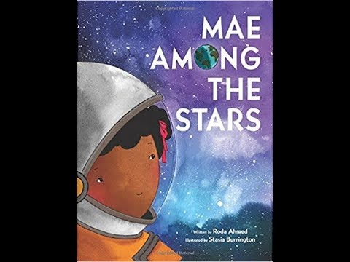
Ask
Affirm
Assist
From Mae among the Stars by Roda Ahmed
Read aloud by Sankofa Read Aloud
©️ Sankofa Read Aloud
Notes:
In this story: When Little Mae was a child, she dreamed of dancing in space. She imagined herself surrounded by billions of stars, floating, gliding, and discovering.
She wanted to be an astronaut. Her mom told her, "If you believe it, and work hard for it, anything is possible.” Despite others not believing in her, Little Mae’s curiosity, intelligence, and determination, matched with her parents' encouraging words, paved the way for her incredible success at NASA as the first African American woman to travel in space
How could you start a conversation if you were reading Mae Among the Stars with your child?
You might consider: Who is making decisions about who/what Mae can be?

Slide 6
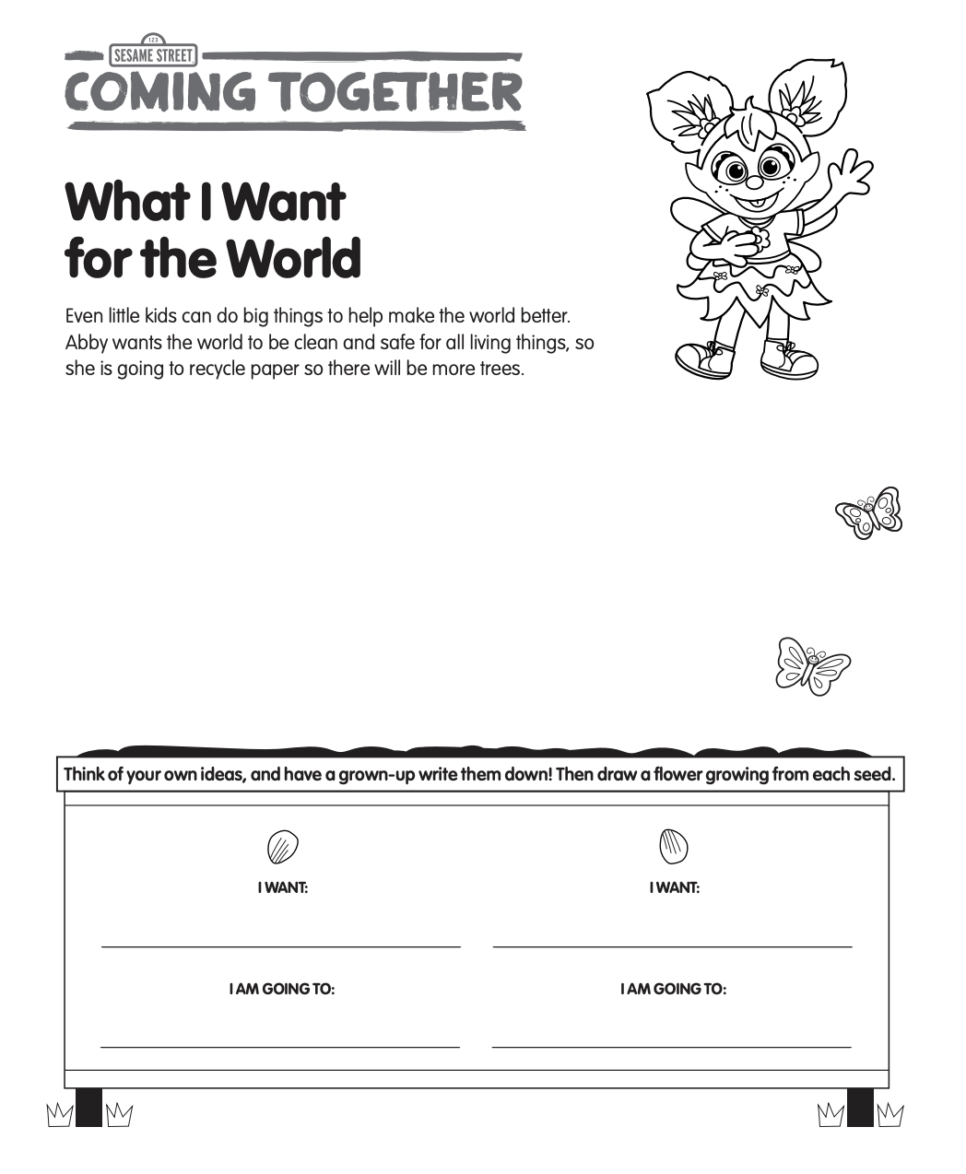
Ask
Affirm
Assist
Notes:
In this activity: Help your child imagine a better world by helping them identify things they want to make the world a better place and also actions that they can take to do so.
How could you start a conversation start a conversation if you were completing this activity with your child?
You may consider: How could you direct your child’s attention to focusing on racial equity within this activity?

Slide 7
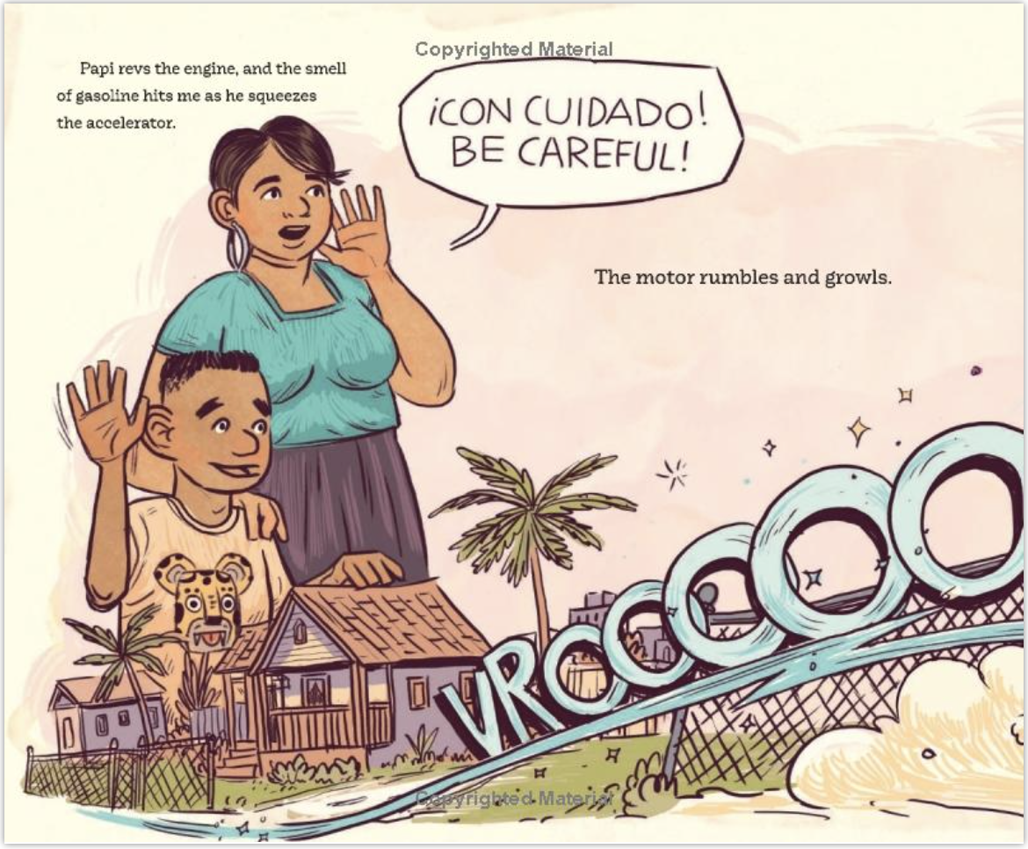
Ask
Affirm
Assist
From My Papi Has a Motorcycle by Isabel Quintero ©️ 2019
Notes:
In this story: When Daisy Ramona zooms around her neighborhood with her papi on his motorcycle, she sees the people and places she's always known. She also sees a community that is rapidly changing around her. But as the sun sets purple-blue-gold behind Daisy Ramona and her papi, she knows that the love she feels will always be there. With vivid illustrations and text bursting with heart, My Papi Has a Motorcycle is a young girl's love letter to her hardworking dad and to memories of home that we hold close in the midst of change.
How could you start a conversation if you were reading My Papi Has a Motorcycle with your child?
You may consider: How can you draw your child’s attention to different ways of communicating (for example, through different languages?). What words does your child use for the same thing?

Slide 8
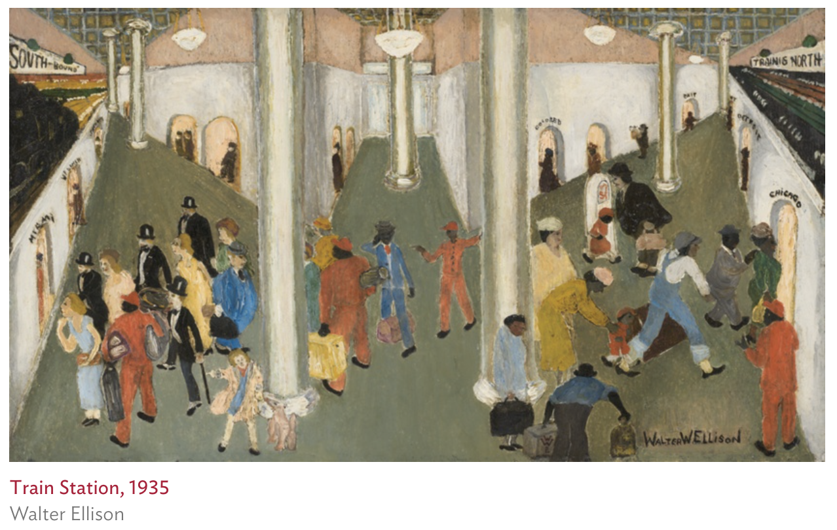
Ask
Affirm
Assist
Notes:
In this activity: Train Station (painted by Walter Ellison) depicts the central terminal of a train station. On the left, white travelers board trains bound for southern vacation destinations. On the right, black passengers depart on northbound trains for cities like Chicago and Detroit, in search of racial equality and economic prosperity. In the center, black porters help white passengers, while black travelers are left to carry their own belongings. Signs over the terminal doorways attest to the racial segregation of this period.
How could you start a conversation start a conversation with your child while viewing this painting?
You may consider: How can you use this as a starting point to cultivate empathy and action? Where does power fit into this conversation? Who is making decisions?

Slide 9
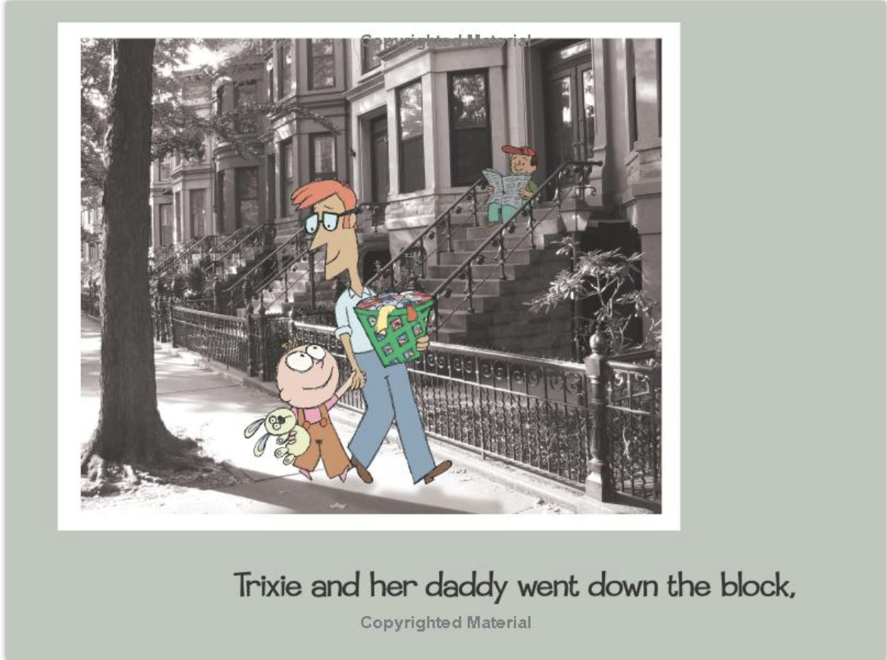
Ask
Affirm
Assist
From Knuffle Bunny by Mo Willems
©️ 2004 Hyperion
Notes:
In this story: Trixie, Daddy, and Knuffle Bunny take a trip to the neighborhood Laundromat. But the exciting adventure takes a dramatic turn when Trixie realizes somebunny was left behind . . .
How could you start a conversation start a conversation if you were reading Knuffle Bunny with your child?
You may consider: Any book can provide opportunities to talk about skin color. The main characters in this book are white, but their skin colors still vary. How could you draw your child’s attention to this?

Slide 10
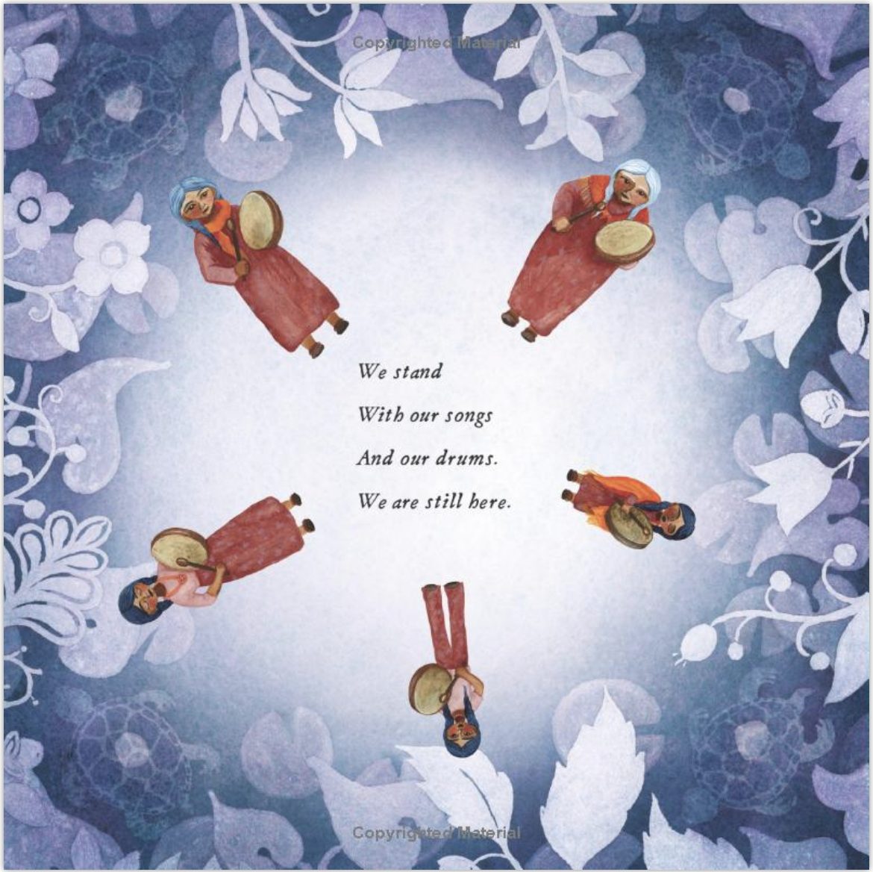
Ask
Affirm
Assist
From We are Water Protectors by Carole Lindstrom ©️ 2021
Notes:
In this story: Inspired by the many Indigenous-led movements across North America, We Are Water Protectors issues an urgent rallying cry to safeguard the Earth’s water from harm and corruption—a bold and lyrical picture book written by Carole Lindstrom and vibrantly illustrated by Michaela Goade.
Water is the first medicine.
It affects and connects us all . . .
When a black snake threatens to destroy the Earth
And poison her people’s water, one young water protector
Takes a stand to defend Earth’s most sacred resource.
How could you start a conversation if you were reading We are Water Protectors with your child?
You may consider: On this page, the characters in the book are standing up for themselves and trying to protect their water. Consider asking your child to identify what they are protesting for; who has power here?

Slide 11
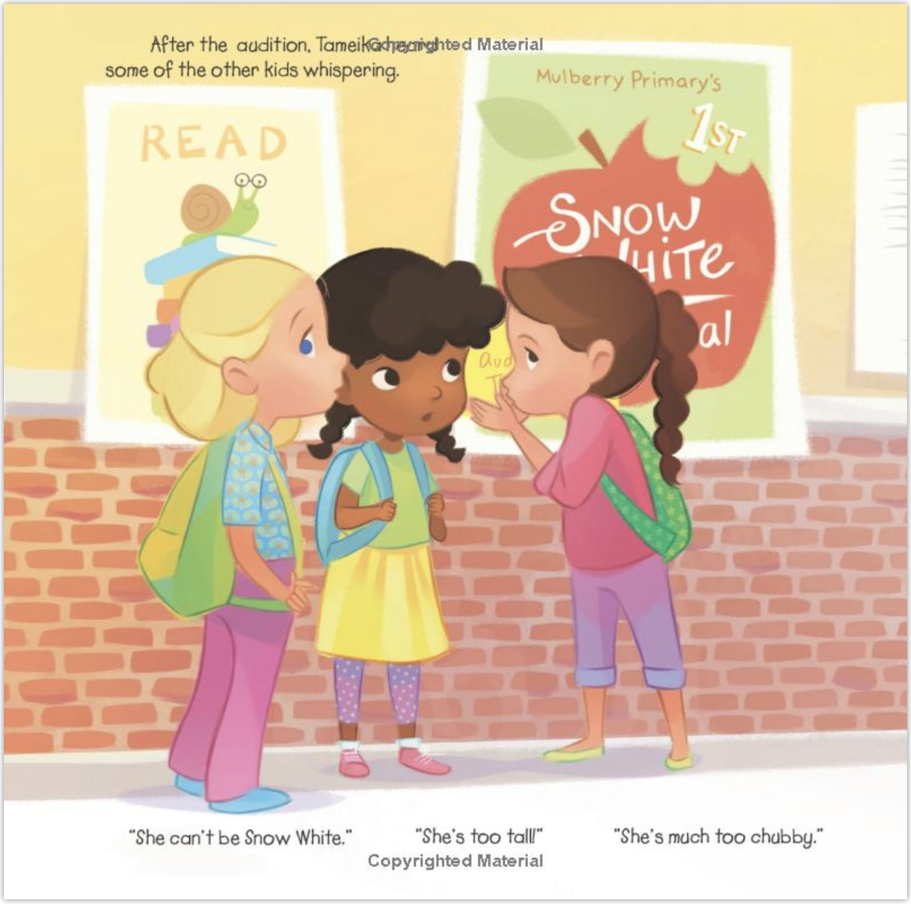
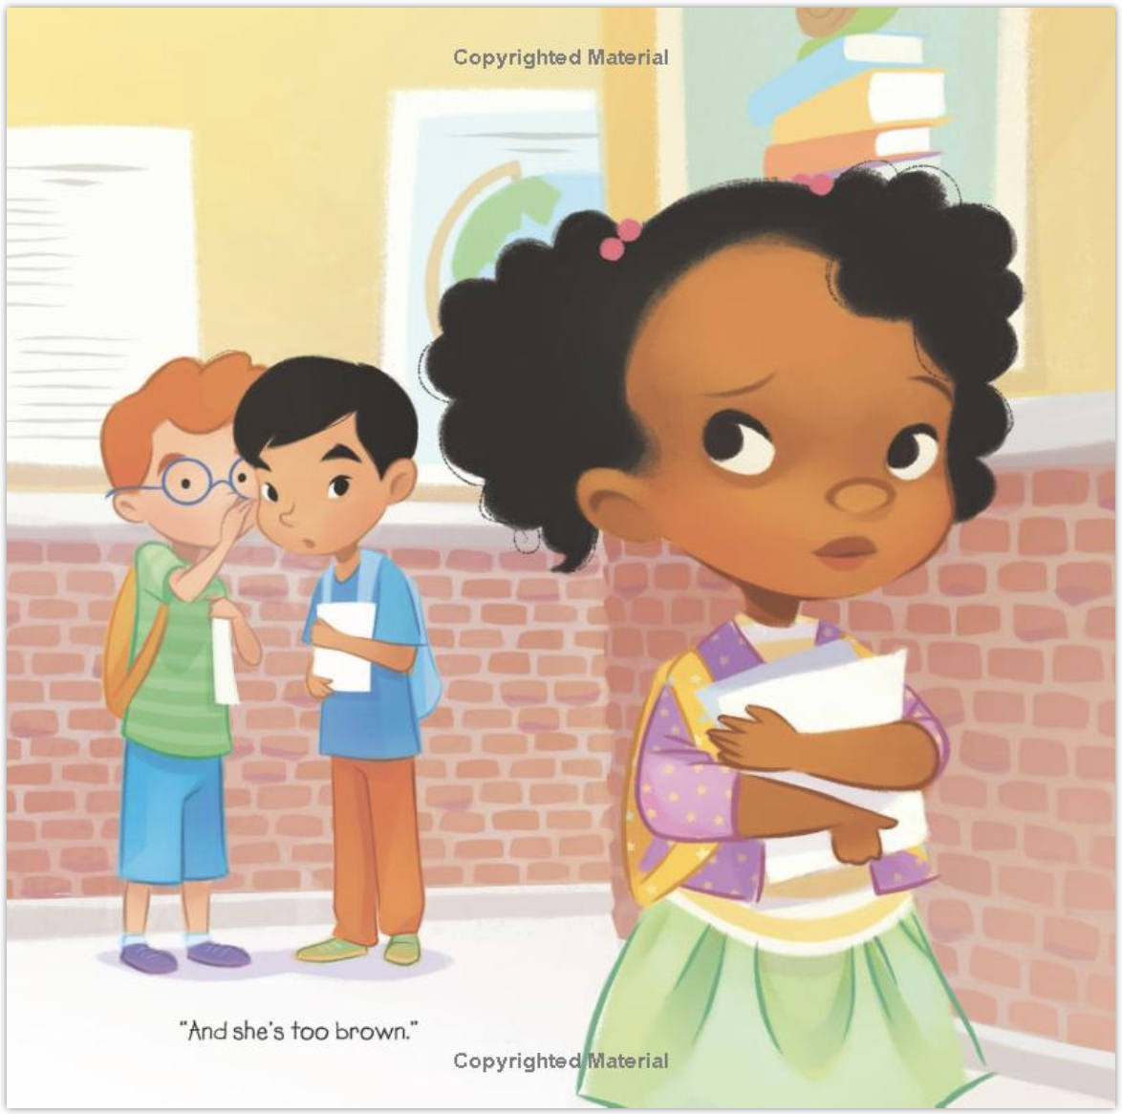
From Not Quite Snow White by Ashley Franklin
©️ 2019 Harper Collins
Ask
Affirm
Assist
Notes:
In this story: Tameika is a girl who belongs on the stage. She loves to act, sing, and dance—and she’s pretty good at it, too. So when her school announces their Snow White musical, Tameika auditions for the lead princess role. But the other kids think she’s “not quite” right to play the role. They whisper, they snicker, and they glare. Will Tameika let their harsh words be her final curtain call?
How might you could start a conversation if you were reading Not Quite Snow White with your child?
You may consider: How can you use this as a starting point to cultivate empathy and action? Where does power fit into this conversation? Who is making decisions?

Slide 12
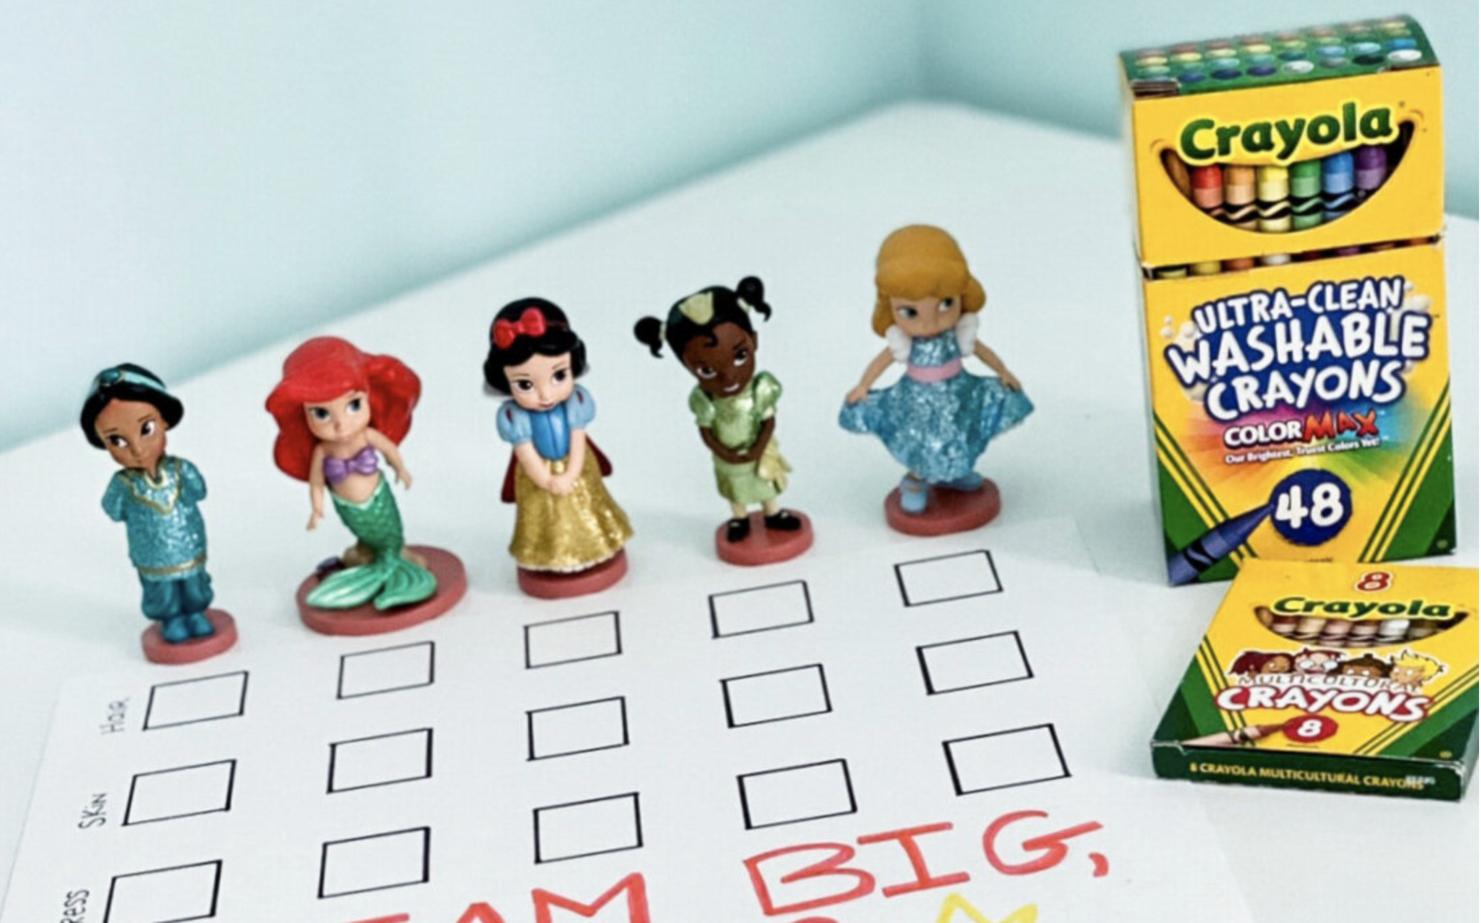
Ask
Affirm
Assist
Notes:
In this activity: All children should be able to have favorite characters that look like them. But, only recently have more representative characters been added to children's books, tv, and movies. Use this activity to talk to your children about representation among their favorite characters. For each character, identify:
- Which crayon would be the best for coloring their hair?
- Which crayon would be the best for coloring their skin?
- Which crayon would be the best for coloring their costume?
How might you could start a conversation if completing this activity with your child?
You may consider: Ask your child what they notice about the characters represented. What skin colors do they have? Why are there more of some and less than others?

Slide 13
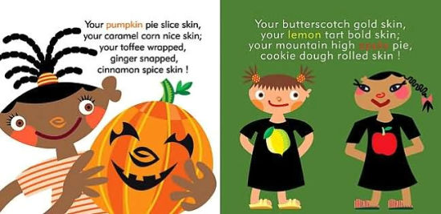
Ask
Affirm
Assist
From The Skin you Live In by Michael Tyler
©️ 2005 Chicago Children’s Museum
Notes:
In this story: Michael Tyler’s kid-friendly, rhythmic prose promotes friendship, acceptance, self-esteem, and diversity. David Lee Csicsko’s vivid illustrations of children swimming in the ocean, hugging, and catching butterflies depict what connects children everywhere: play.
How could you start a conversation a conversation if you were reading The Skin You Live In with your child?
You might consider: How can you highlight skin color differences within your own family?

